Slide 1
IBM HACK CHALLENGE
NAME: K N S Harshita,J Shravani
MAIL ID: nagasaiharshita.kaza@gmail.com, shravanijalli@gmail.com
PROJECT ID: SPS_PRO_1863
PROJECT TITLE: Predicting output energy from a wind turbine based on weather conditions

Slide 2
Predicting Output Energy from a Wind Turbine based on weather conditions
“wind energy prediction based on IOT is done with the
cloud platform. We use IBM Watson Iot platform ,Open
weather API and Node-Red”

Slide 3
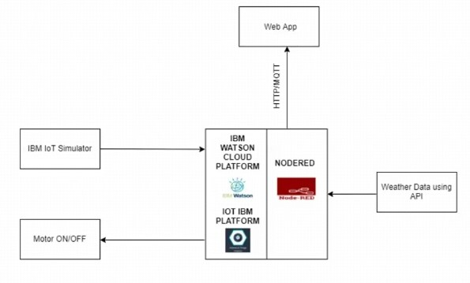
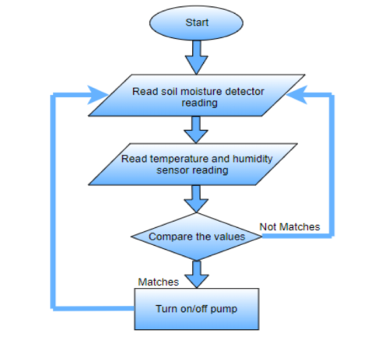
BLOCK DIAGRAM:
FLOW CHART:

Slide 4
FUTURE SCOPE:
IoT in agriculture technologies comprise specialized equipment, wireless connectivity, software and IT services.
BI Intelligence survey expects that the adoption of IoT devices in the agriculture industry will reach 75 million in 2020, growing 20% annually. At the same time, the global smart agriculture market size is expected to triple by 2025, reaching $15.3.
Smart farming based on IoT technologies enables growers and farmers to reduce waste and enhance productivity ranging from the quantity of fertilizer utilized to the number of journeys the farm vehicles have made, and enabling efficient utilization of resources such as water, electricity, etc.
Predictive analytics for smart farming Crop predication plays a key role, it helps the farmer to decide future plan regarding the production of the crop, its storage, marketing techniques and risk management.
Farmers have started to realize that the IoT is a driving force for increasing agricultural production in a cost-effective way.
Because the market is still developing, there is still ample opportunity for businesses willing to join in.

Slide 5

THANK YOU

